Slide 1
Secure data hiding in images using steganography
CAPSTONE PROJECT
Presented By: BEERA RENUKA RAMANI
Student Name : BEERA RENUKA RAMANI
College Name & Department : KIET ENGINEERING COLLEGE

Slide 2
OUTLINE
Problem Statement
Technology used
Wow factor
End users
Result
Conclusion
Git-hub Link
Future scope

Slide 3
Problem Statement
Traditional encryption methods are easily detectable and can raise suspicion.
Need for a secure way to hide confidential messages within images.
Ensuring data security while maintaining the integrity of the cover image.
Making encryption and decryption accessible to non-techinal users through a simple interface.

Slide 4
Technology used
Programming language : python
Image Processing Library : OpenCV
Graphical User Interface (GUI) : Tkinter
File Handling & Security : Basic encryption logic for password protection
Additional Libraries : Pillow
Platform : Windows

Slide 5
Wow factors
Uses steganography to embed a message into an image without noticeable changes.​
User-friendly GUI for easy encryption and decryption.​
Lossless data hiding using pixel value manipulation instead of traditional cryptographic techniques.​
Works on any standard image file format (PNG recommended for best results). ​

Slide 6
End users
Cybersecurity Enthusiasts – Exploring secure communication techniques.​
Government & Defense – Secure message transmission without raising suspicion.​
Journalists & Activists – Concealing sensitive information in images to avoid surveillance.​
Software Developers – Learning steganography concepts and their applications. ​

Slide 7


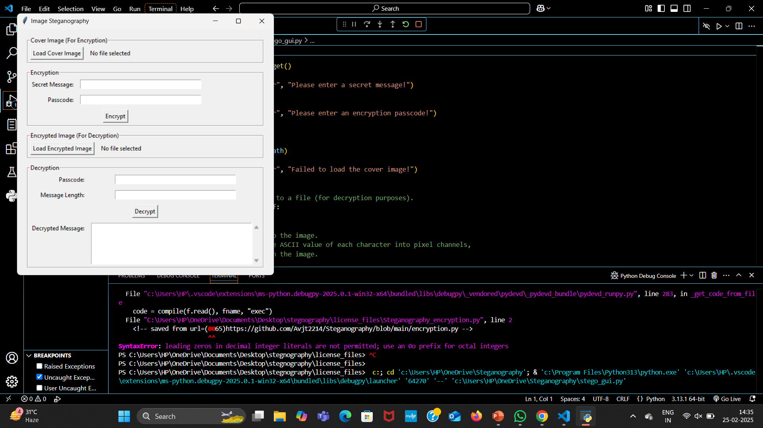
Results

Slide 8
Conclusion
Steganography provides a covert way of communicating sensitive information.​
This project showcases a simple yet effective implementation of message hiding in images.​
The GUI makes encryption and decryption accessible even to non-technical users.​
Future improvements can make it more robust, secure, and scalable.​

Slide 9
GitHub Link
https://github.com/RenukaRamani-02/MY-PROJECT-AICTE-.git

Slide 10
Future scope(optional)
Advanced Encryption Techniques – Integrate AES encryption before embedding text in images.​
Support for Audio & Video Steganography – Expanding beyond images.​
AI-based Detection Prevention – Ensuring messages stay undetectable from modern forensic tools.​
Mobile App & Web Version – Expanding accessibility beyond desktops.​
Multi-Layer Security – Combining steganography with blockchain for ultra-secure communication. ​

Slide 11
THANK YOU

